Slide 1
Grid & Random Layouts in ML
By: L Vinay Rajiv Reddy

Slide 2
What is Hyper parameter Tuning ?
Parameter :
A configuration variable that is internal to the model
whose value can be estimated from the given data.
Eg : weights , Support Vectors, Co efficients
Hyper parameters ?
A configuration that is external to the model
whose value cannot be estimated from data.
Eg: K in KNN, Learning rate in Neural Networks

Slide 3
Why is Hyper parameter Tuning ?
For better accuracy
Proper prediction

Slide 4
How to tune ?
Although there are many techniques, the major ones are :
1) Grid Search
2) Random Search

Slide 5
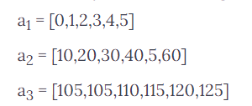
1) Grid Search
will methodically build and evaluate a model for each combination of algorithm parameters specified in a grid.

Slide 6
2) Random Search :
We define a sampling distribution for each hyper parameter.
could also define how many iterations we’d like to build when searching for the optimal model.
Reason to prefer : for most cases, hyper parameters are not equally important, so grid fails here.

Slide 7
